Slide 1
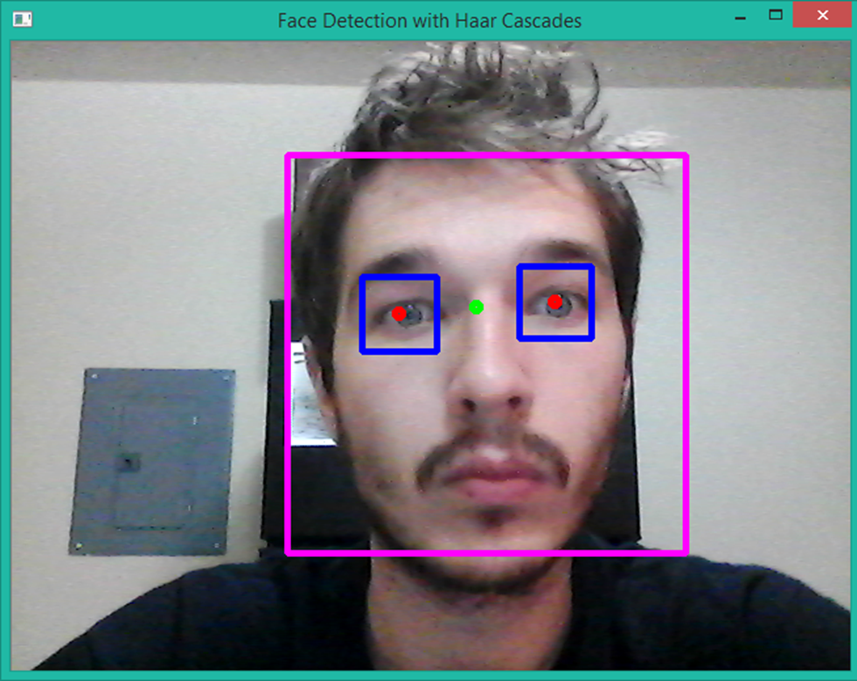
Face detectıon & Eye trackıng
Ali Arda Eker

Slide 2
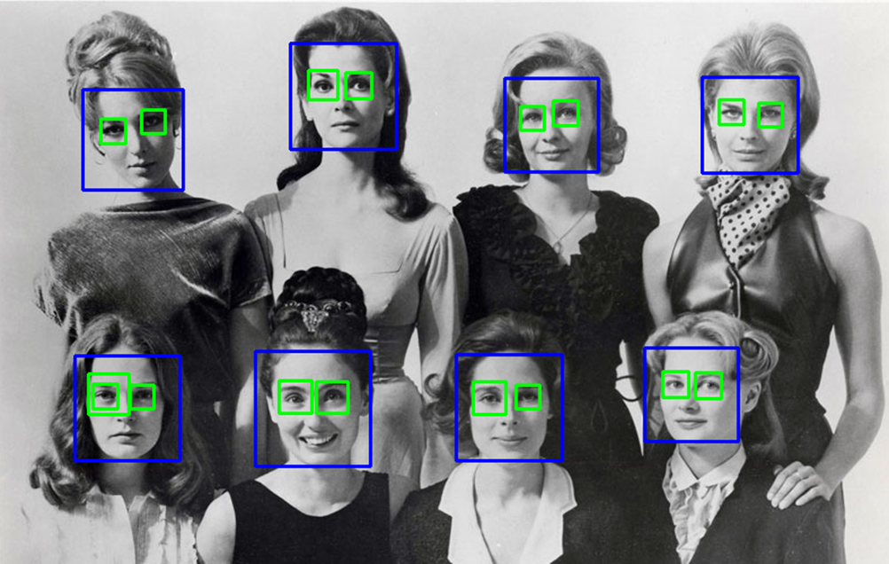
Goal:
Detecting the face and capturing the eyes within that face.
Calculating position of irises and a center point of those irises.
Measuring the change of the position of center points between 2 consequtive frames in x and y direction in order to determine where user looks at horizontally and vertically.

Slide 3
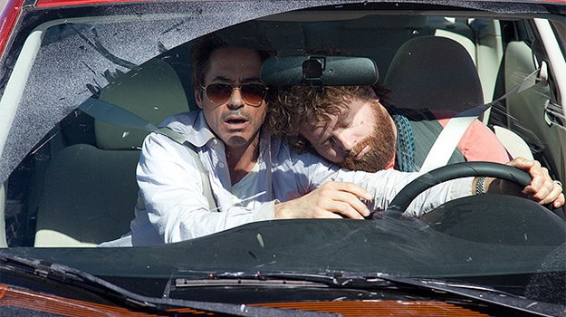
APPLICATIONS:
Road Safety: Can be used to detect driver’s mood in order to check if he or she is sleepy or anxious. Also checks driver’s scanning ability.
Healthcare Assistance: Detecting paralyzed patients’ iris movements in order to move a wheelcair
Security: Face and iris detection programs to verify users’ identity

Slide 4
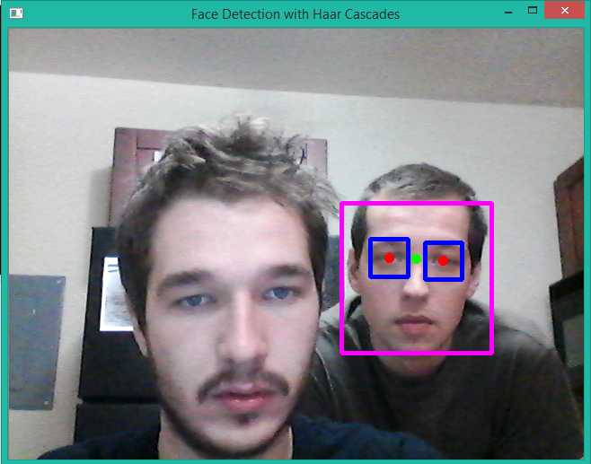
Requırements:
Plain and simple background without pictures or figures that can be detected as face.
User should be alone for camera to detect only his or her face within the vision.
No obstacles that can alter the detection rate such as sun glasses, hat, scarf, beard or mustache

Slide 5

Framework:
OpenCV:
Open source computer vision library.
Has C++, C, Python and Java intefaces that supports Windows, Linux, Mac OS and Android.
Usage ranges from interactive art to mines inspection and advanced Robotics.
47K people of user community, 9M downloads.
Used its C++ interface within Windows and Visual Studio 2015 Community Edition.

Slide 6
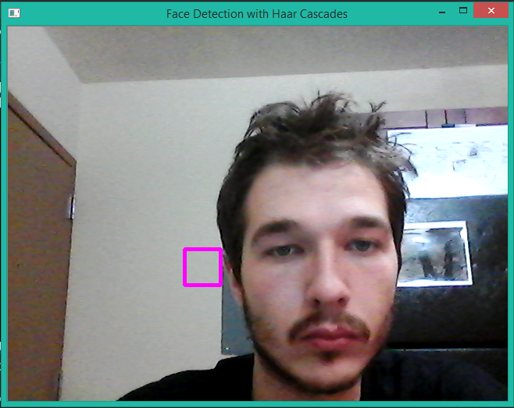
Detectıon rate:
FN = 1 – d
Detection Rate (d): Percentage of faces in a video stream that have been correctly detected. We want to maximize this.
False Negative (FN): Rate of faces that are forgotten.
False Positive (FP): Rate of non faces that are classified as faces. We want to minimize this.

Slide 7
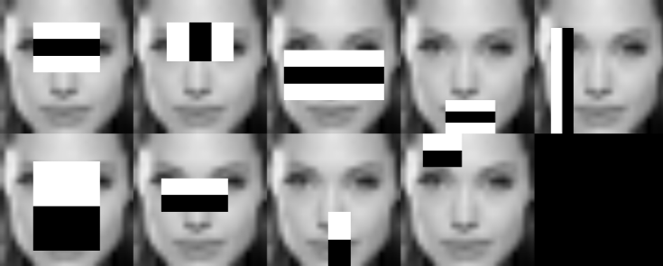
Haar Feature-Base cascade classıfıers
Effective object detection method proposed by Paul Viola and Michael Jones in 2001.
Machine learning approach where a cascade function is trained from a lot of positive and negative images.
Then it is used to detect objects in other images.
Different cascade classifiers are used to detect faces and eyes

Slide 8
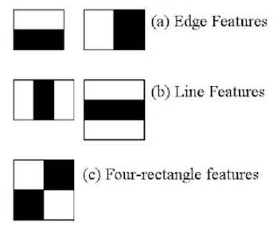
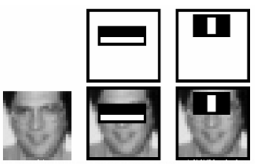
CLASSIFICATION
Features are kernels.
Each feature is a single value obtained by subtracting the sum of pixels under white area from sum of pixels under black area.
All possible sizes and locations of each feature is used to calculate plenty of features.
OpenCV contains many pre-trained classifiers for face, eyes, smile, etc.

Slide 9
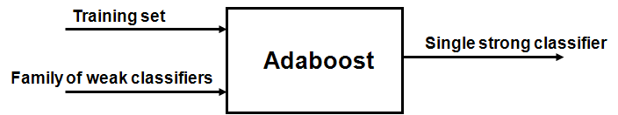
adaboost
Used to discard irrelevant features.
We apply every feature on all of the training images and choose the ones with minimum error rate.
Final classifier is a weighted sum of many week classifiers
Reduction from 160K features to 6K features

Slide 10
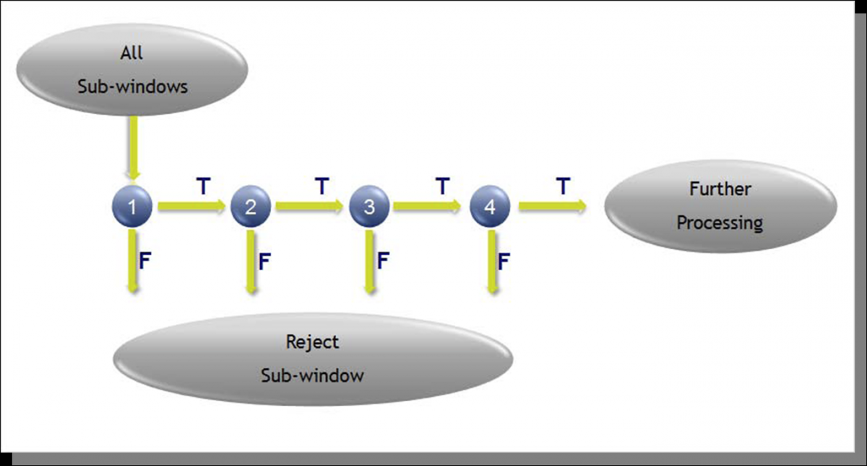
Cascade of classıfıers
Applying 6K features is still inefficient and time consuming.
Most of an image is non face area so it is better to check if an image is not a face region
Group the features into different stages of classifiers and apply them one by one. If a image fails in firts stage discard it.
Viola-Jones detector has 6K features with 38 stages 1, 10, 25, 25 and 50 features in first 5 stages.

Slide 11

algorıthm
Getting the camera stream and parsing it into frames
For each frame convert it from RGB to gray scale
Then equalize the histogram of each frame in order to normalize brightness and increase the contrast
Detect the faces first using face cascades.
Then detect the eyes within the face found using eyes cascades.
Finally calculate the position of irises and their central point to plot them.

Slide 12
CODE BEHIND / DEMO

